Slide 1

Notes:
https://youtu.be/DetutCAi47I

Slide 2
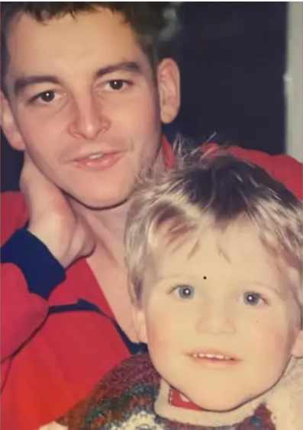

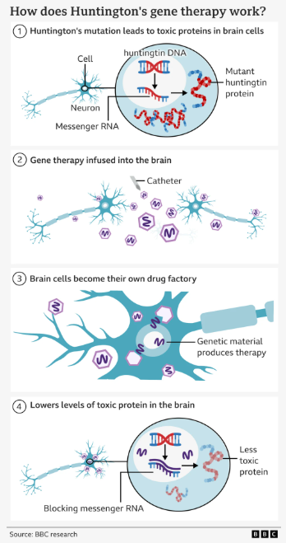
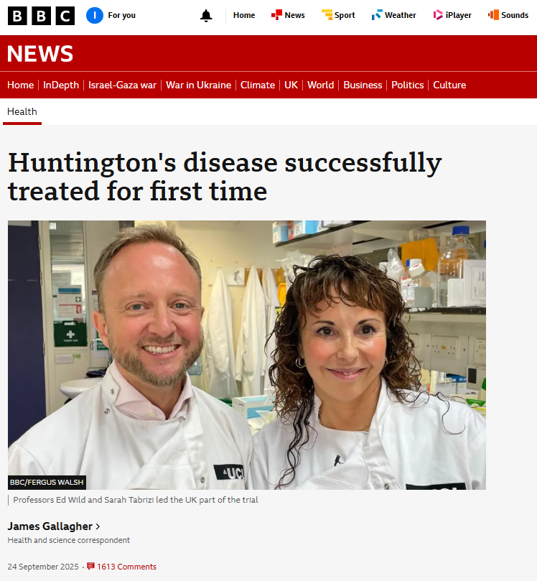
Genetic medicine combining gene therapy and gene silencing technologies.
c £2.6m
Haemophilia B

Slide 3
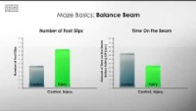
Notes:
https://youtu.be/09pEAIFQ4ck

Slide 4
Which type (Het/Wild) of mice showed more slips (indication of poor motor activity i.e. HD)
Any correlation with sex or age?
Can any side (right/left/front/rear) limb be a predominant factor correlated with HD

